Slide 1
Interactive Programming with PyQt5
GA GIS CoP
October 2019

Slide 2
Outline
Qt Background
Installing Qt and PyQt5
GUI Design
Interacting with Widgets
Signals and Slots
Demonstration

Slide 3
Qt Background
Qt is a set of C++ libraries and development tools that includes platform independent abstractions for graphical user interfaces, networking, threads, regular expressions, SQL databases, SVG, OpenGL, XML, user and application settings, positioning and location services, short range communications (NFC and Bluetooth), web browsing, 3D animation, charts, 3D data visualisation and interfacing with app stores. PyQt5 implements over 1000 of these classes as a set of Python modules.
Called Qt because the letter Q looked appealing in Emacs typeface, and "t" was inspired by Xt, the X toolkit.

Slide 4
Qt Background
Qt was originally developed by Haavard Nord and Eirik Chambe-Eng at TrollTech in Finland in 1990, with an open source version for X11/Unix and a proprietary version for Windows.
In 2000, Qt/X11 2.2 was released under the GPL v2 and for Windows under the GPL in June 2005

Slide 5
Qt Background
Nokia acquired TrollTech in 2008 and focused resources into their Symbian mobile OS with Qt as the main development platform.
In 2011 Nokia dropped Qt in favour of Windows Phone. This had made many people very angry and has been widely regarded as a bad move. They sold Qt to Digia, who carved it off into the Qt Company in 2014.

Slide 6
Qt Background
Qt is currently being developed by The Qt Company, a publicly listed company, and the Qt Project under open-source governance, involving individual developers and organizations working to advance Qt. Qt is available under both commercial licenses and open source GPL 2.0, GPL 3.0, and LGPL 3.0 licenses.

Slide 7
Qt Background: Examples
Qt in the wild:
Google Earth
KDE Plasma
Tesla Model S in-car UI
Mathematica
TeamViewer
VLC Media Player
Blizzard Entertainment.
Dreamworks
Lucasfilm
Valve Corporation

Slide 8
Qt Background: Platforms
Qt Platforms:
Linux
X11, Android, Wayland
Microsoft
Windows (XP, Vista, 7, 8, 10)
Apple
iOS, MacOS (via Cocoa API)

Slide 9
Qt Background: Languages
Language bindings
C++
C#
Go
Haskell
JavaScript
Java
Pascal
PYTHON
Ruby
Rust

Slide 10
Qt Background: Python Bindings
PyQt is python bindings developed by the British firm Riverbank Computing using the SIP binding generator
PySide is python bindings developed by Finnish firm The Qt Company using the shiboken binding generator
Similar functionality
Different developers, licensing terms, documentation, platforms, binding generators

Slide 11
Installing Qt (14GB installed)
Windows:
online or offline installers: https://www.qt.io/download-qt-installer
Ubuntu:
sudo apt install build-essential, qtcreator, qt5-default, pyqt5-dev-tools, qttools5-dev-tools
At GA:
Installed with QGIS

Slide 12
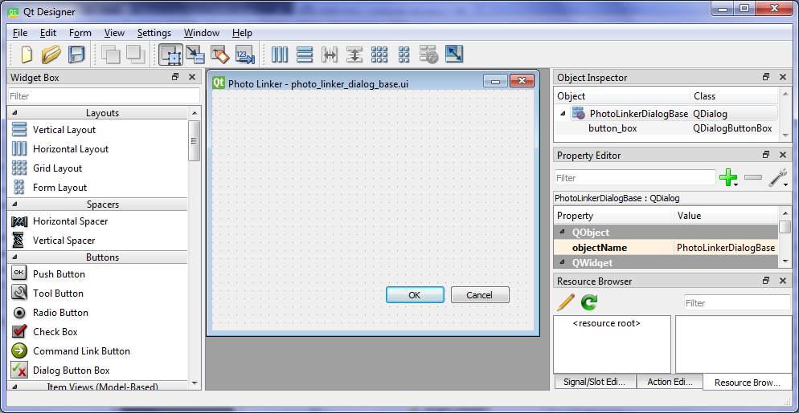
GUI Design: Qt Designer
Element Name
Drag elements onto the form

Slide 13
GUI Design: Qt Resources
http://pyqt.sourceforge.net/Docs/PyQt5/resources.html
PyQt5 supports Qt’s resource system. This is a facility for embedding resources such as icons and translation files in an application. This makes the packaging and distribution of those resources much easier.
A .qrc resource collection file is an XML file used to specify which resource files are to be embedded.
pyrcc5 reads the .qrc file, and the resource files, and generates a Python module that only needs to be imported by the application in order for those resources to be made available just as if they were the original files.

Slide 14

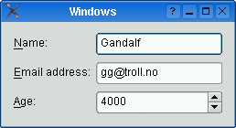

GUI Design: Layouts
Automatically position elements on your form
QVBoxLayout - 1 Vertical column
QHBoxLayout - 1 Horizontal row
QGridLayout - rows and columns with grid reference system
QFormLayout - 2 columns (label, then input widget)

Slide 15
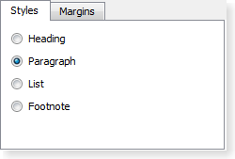
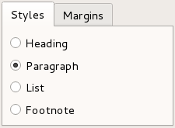
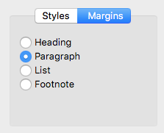
GUI Design:
Styles
QWindowsVistaStyle
QFusionStyle
QMacStyle

Slide 16
The QApplication
There can be only one QApplication, it manages:
user desktop settings (fonts, doubleclick interval)
event handling from underlying window system
parse command line arguments (style, debugging)
defines look and feel (style)
localisation (translation)
clipboard
mouse cursor

Slide 17
Querying Widgets: getting information
Importing the QT Designer ui file as a class.
# import the dialog form as a class
from dialogScript import DialogClass
# instantiate the dialog form class
def __init__(self):
self.dialog = DialogClass()
self.dialog.show()
# query the dialog class radioButton element’s status
self.dialog.radioButton.isChecked()

Slide 18
Querying Widgets: setting information
# populate a comboBox element with sequential values
for i in range(10):
self.dialog.comboBox.addItem(str(i))
# set a checkBox to checked
self.dialog.checkBox.setChecked(True)
# set the text for a textLabel
self.dialog.textLabel.setText(“sample text”)

Slide 19
Event Loops are Dead
Game event loop pseudo-code:
while not ExitCondition:
check for user input
run AI
move enemies
resolve collisions
draw graphics
play sounds

Slide 20
Event Loops are Dead
Event Loops block until an event has arrived
This is bad.
Asynchronous signal handlers are much better

Slide 21
Event Loops are (not) DEAD
QApplication.exec() ???
This command enters the main event loop to start event handling (user interaction)
When a signal calls a slot it is executed immediately, independent of the GUI event loop.

Slide 22
Signals and Slots (user interaction)
Interactive Programming relies on signals:
A signal is emitted when something of potential interest happens. A slot is a Python callable. If a signal is connected to a slot then the slot is called when the signal is emitted. If a signal isn’t connected then nothing happens. The code (or component) that emits the signal does not know or care if the signal is being used.

Slide 23
PyQt5 Signals and Slots
# slot - executes an action
def printValue():
print(self.textToPrint)
# signal - initiates an action
self.dialog.spinBox.valueChanged.connect(printValue)
Notice there are no arguments passed?

Slide 24
Demonstration: Hello, World!
Hello World!, first step in interactive python
A window with a label that says “Hello World!”

Slide 25
Topics not covered in this presentation
Internationalisation (translations)
Documentation (sphinx: HTML, LaTeX, epub, man, QtHelp)
Testing
unit testing
assertions
doctest
property-based testing
code profiling
Remote debugging
Security (sql injection, user input sanitation, web security)
Compiling an executable or installer
PySide

Slide 26
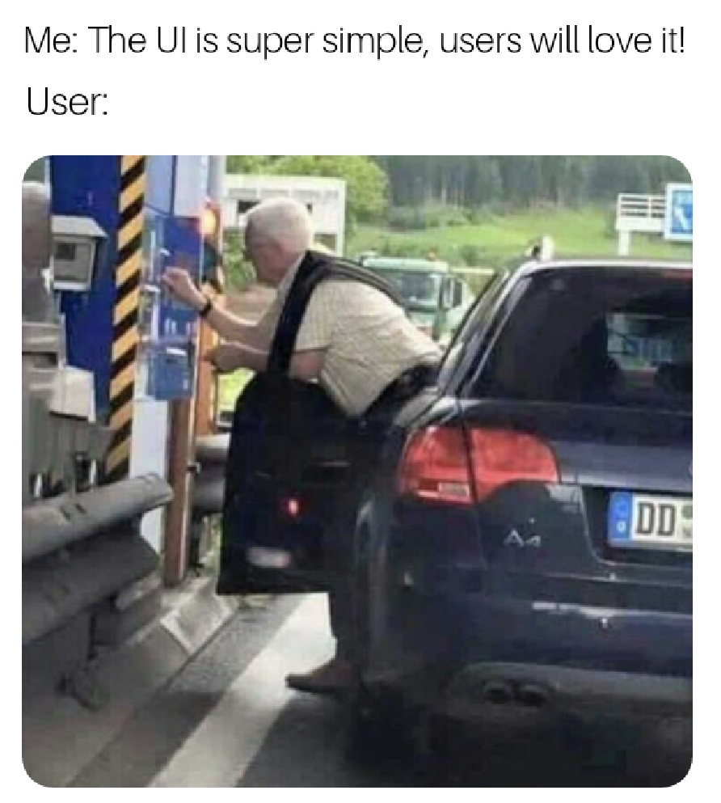
Topics not covered in this presentation
UI Design

Slide 27
License: CC BY 4.0
Jonah Sullivan,
e jonah.sullivan@ga.gov.au
t +61 (0) 2 6249 9516

